Slide 1
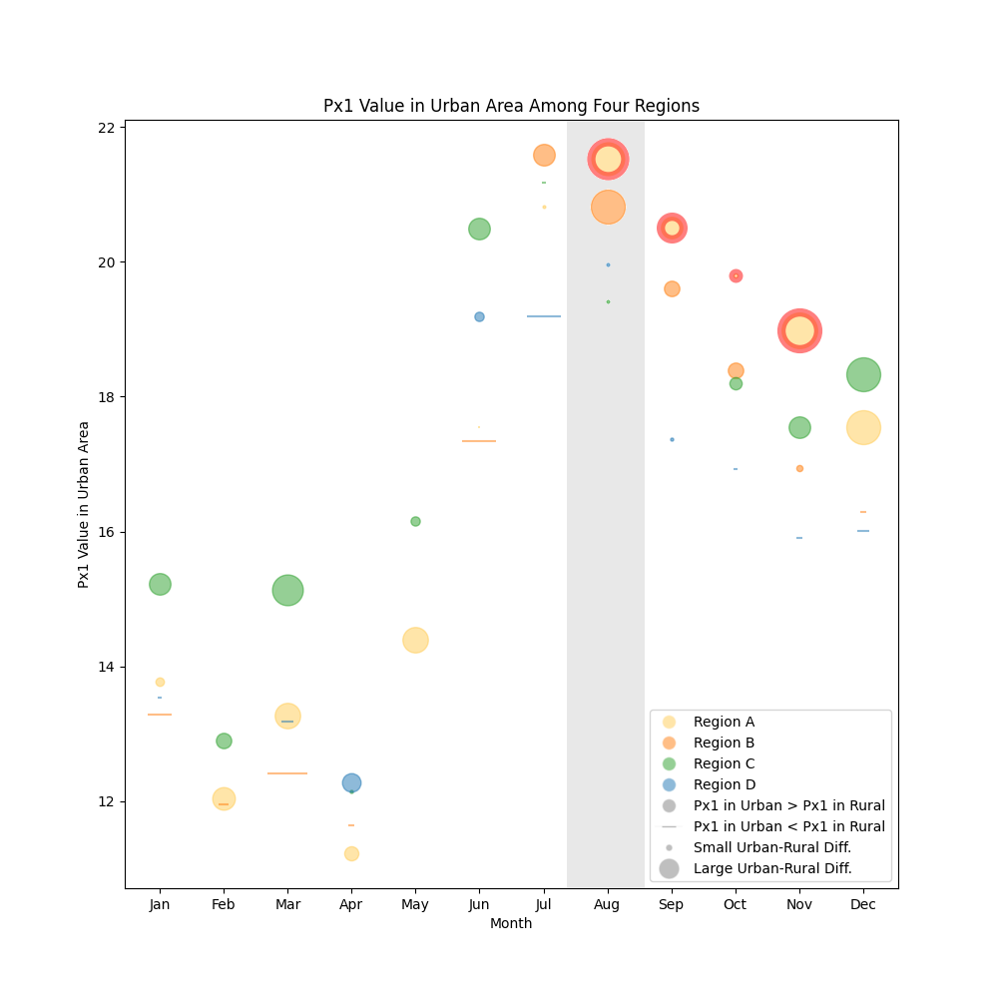
Ex5a-2
2 results highlighted in our graph:
1. Regions A’s Px1 values in urban areas between August and November are higher than in other regions.
Red edge colour around urban Region A between August and November.
2. Regions A and B exhibit relatively high values in August.
Vertical bar from top to bottom of graph for August.
Improvements based on critiques:
Moved legend to bottom right corner for better use of space and less crowding around our highlighted points.
Replaced unintentionally salient points (large triangle glyphs) with less noticeable markers (thin horizontal lines) so as not to take away from the results we intended to highlight.
Used two different markers to differentiate between the 2 highlighted results (from all red edge colour to addition of shadows).
We feel that our graph is successful in our conventional approach of representing all 4 graphs from the paper while highlighting two results described by the authors. Our use of pre-attentive cues such as different sizes and colours make for salient points.

